Slide 1
HOSPITAL MANAGEMENT SYSTEM
PRESENTED BY:
N.Vanitha
Ss.Sriharithaa
R.Nowsheen
S.Poornima
D.Nivedha

Slide 2
CONTENTS
H
H
01
INTRODUCTION
02
PROJECT DESCRIPTION
03
SOFTWARE REQUIREMENT
04
CONCLUSION

Slide 3
INTRODUCTION
Hospital are the essential part of our lives, providing best medical facilities to people suffering from various conditions.
It is neccessary for the hospitals to keep track of its day-to-day activities & records of its patients,doctors and other staffs.

Slide 4
This helps to keep the hospital running smoothly & successfully.
Thus keeping the working of the manual system as the basis of
our project.We have developed an automated version of the manual system,named as Hospital Management System.

Slide 5
PROJECT DESCRIPTION
The Aim of our Project is to provide paperless Hospital.
It also aims at providing low-cost reliable automation of the existing systems.
The system also provides excellent security of data at every level of user-system interaction and also provides robust & reliable storage and backup facilities.

Slide 6
ADVANTAGES :
Avoid errors and track every single details.
Better revenue managemnt.
Improve data security.
Establish your hospital as technically advanced.

Slide 7
DISADVANTAGES :
The high cost of software development and deplan.
The chances of employment usually become less with the automation of the system.
Inconsistency and Inefficiency.

Slide 8
SOFTWARE REQUIREMENT
FRONT END :
HTML
CSS
JAVA SCRIPT
BACK END :
CORE JAVA
SPRING BOOT
JPA
HIBERNATE

Slide 9
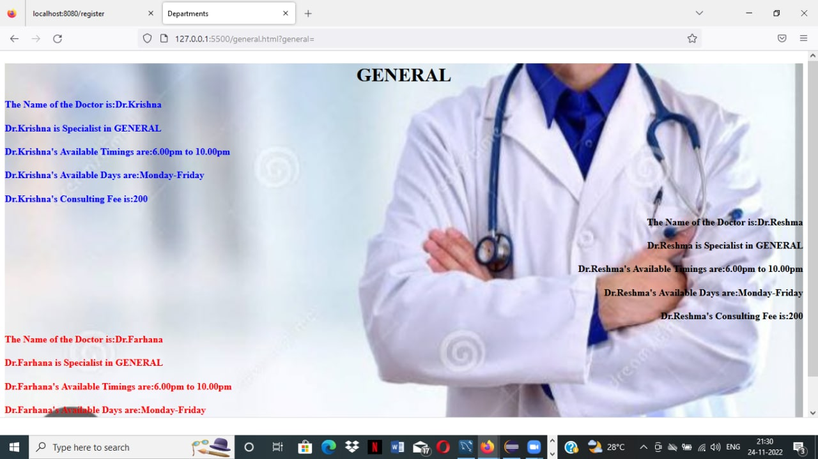

Slide 10
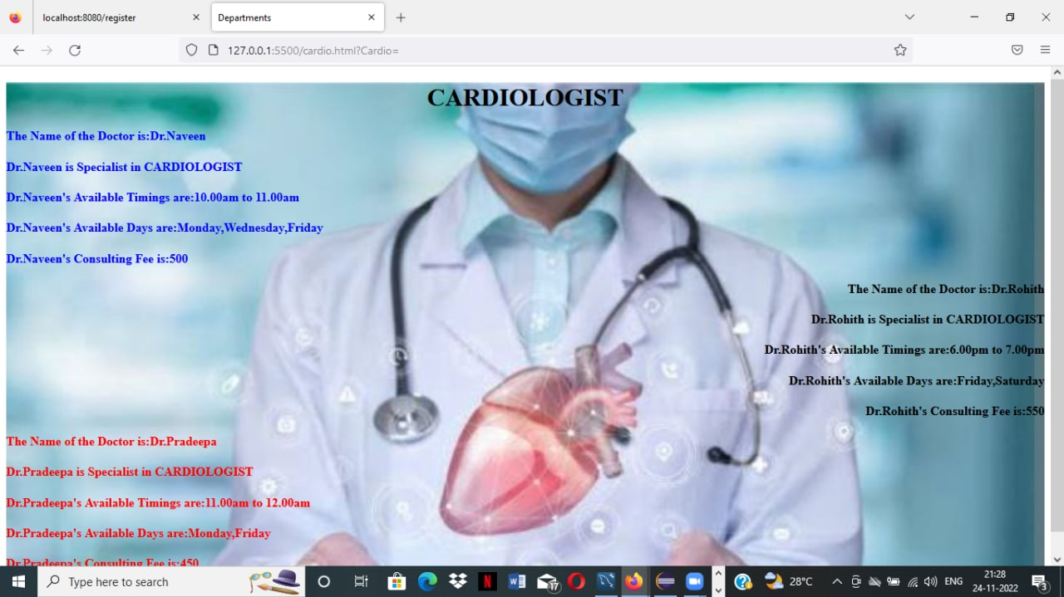

Slide 11


Slide 12


Slide 13


Slide 14


Slide 15

c conclusion
Hospital Management System is all about the modernizing a hospital through use of technology.
Computers helps in it and take over the manual system for quick and easy functioning.
It gives many facilities like searching for the detail of patient as well as the creation of test reports.

Slide 16
THANK YOU
2017/5/14

